Slide 1

Project 1 Team 3 Analysis of selected World Events To Inflation
/Wo

Slide 2

Hypothsis: World Events adversely affected prices of products and goods.

Slide 3
* Which world events are heavily visible in a variety of commodity prices? * Do prices decrease to normal after world events? If so, how long does it take? * Are there any items that appear to have been affected uniquely by one major event? * How does each items price increase compare to yearly inflation?

Slide 4
World Events in question: Oil Crash: 2014-2016 Covid 19: March 2020 Ever Given: March 2021 Ukraine/Russian War: March 2021 Avian Flu: 2016 & February 2022

Slide 5
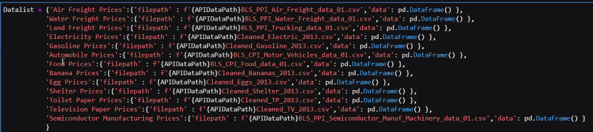
Import of API and CSV data Source: US Bureau of Labor Statistics

Slide 6
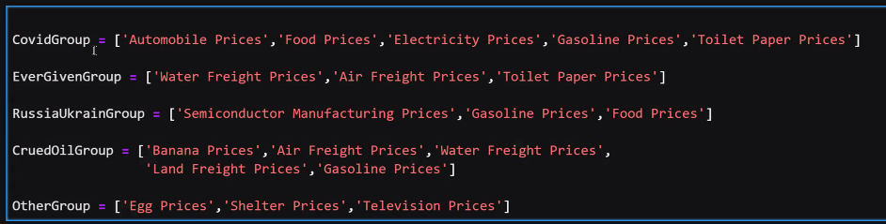
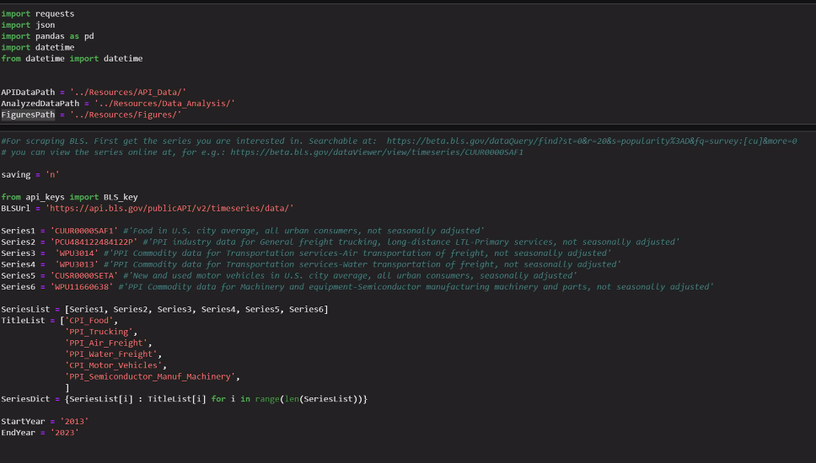

Slide 7
Air freight prices Water freight prices Land freight prices Electricity prices Gasoline prices Shelter prices Semiconductor manufacturing machinery prices

Slide 8
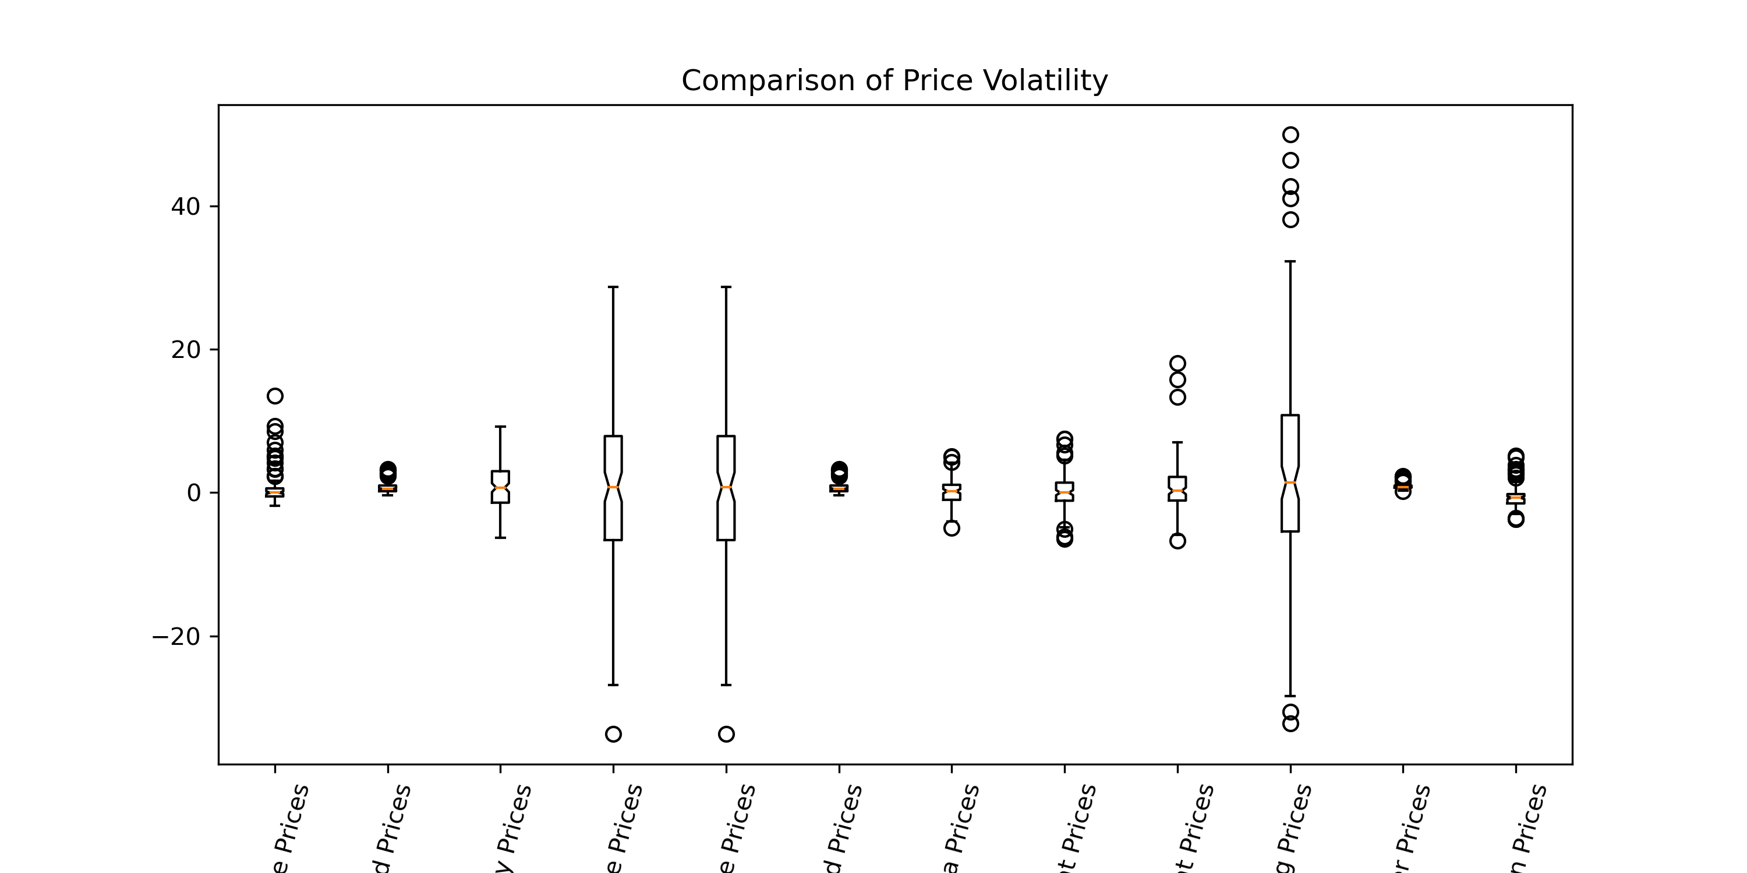
Volatility Comparison

Slide 9
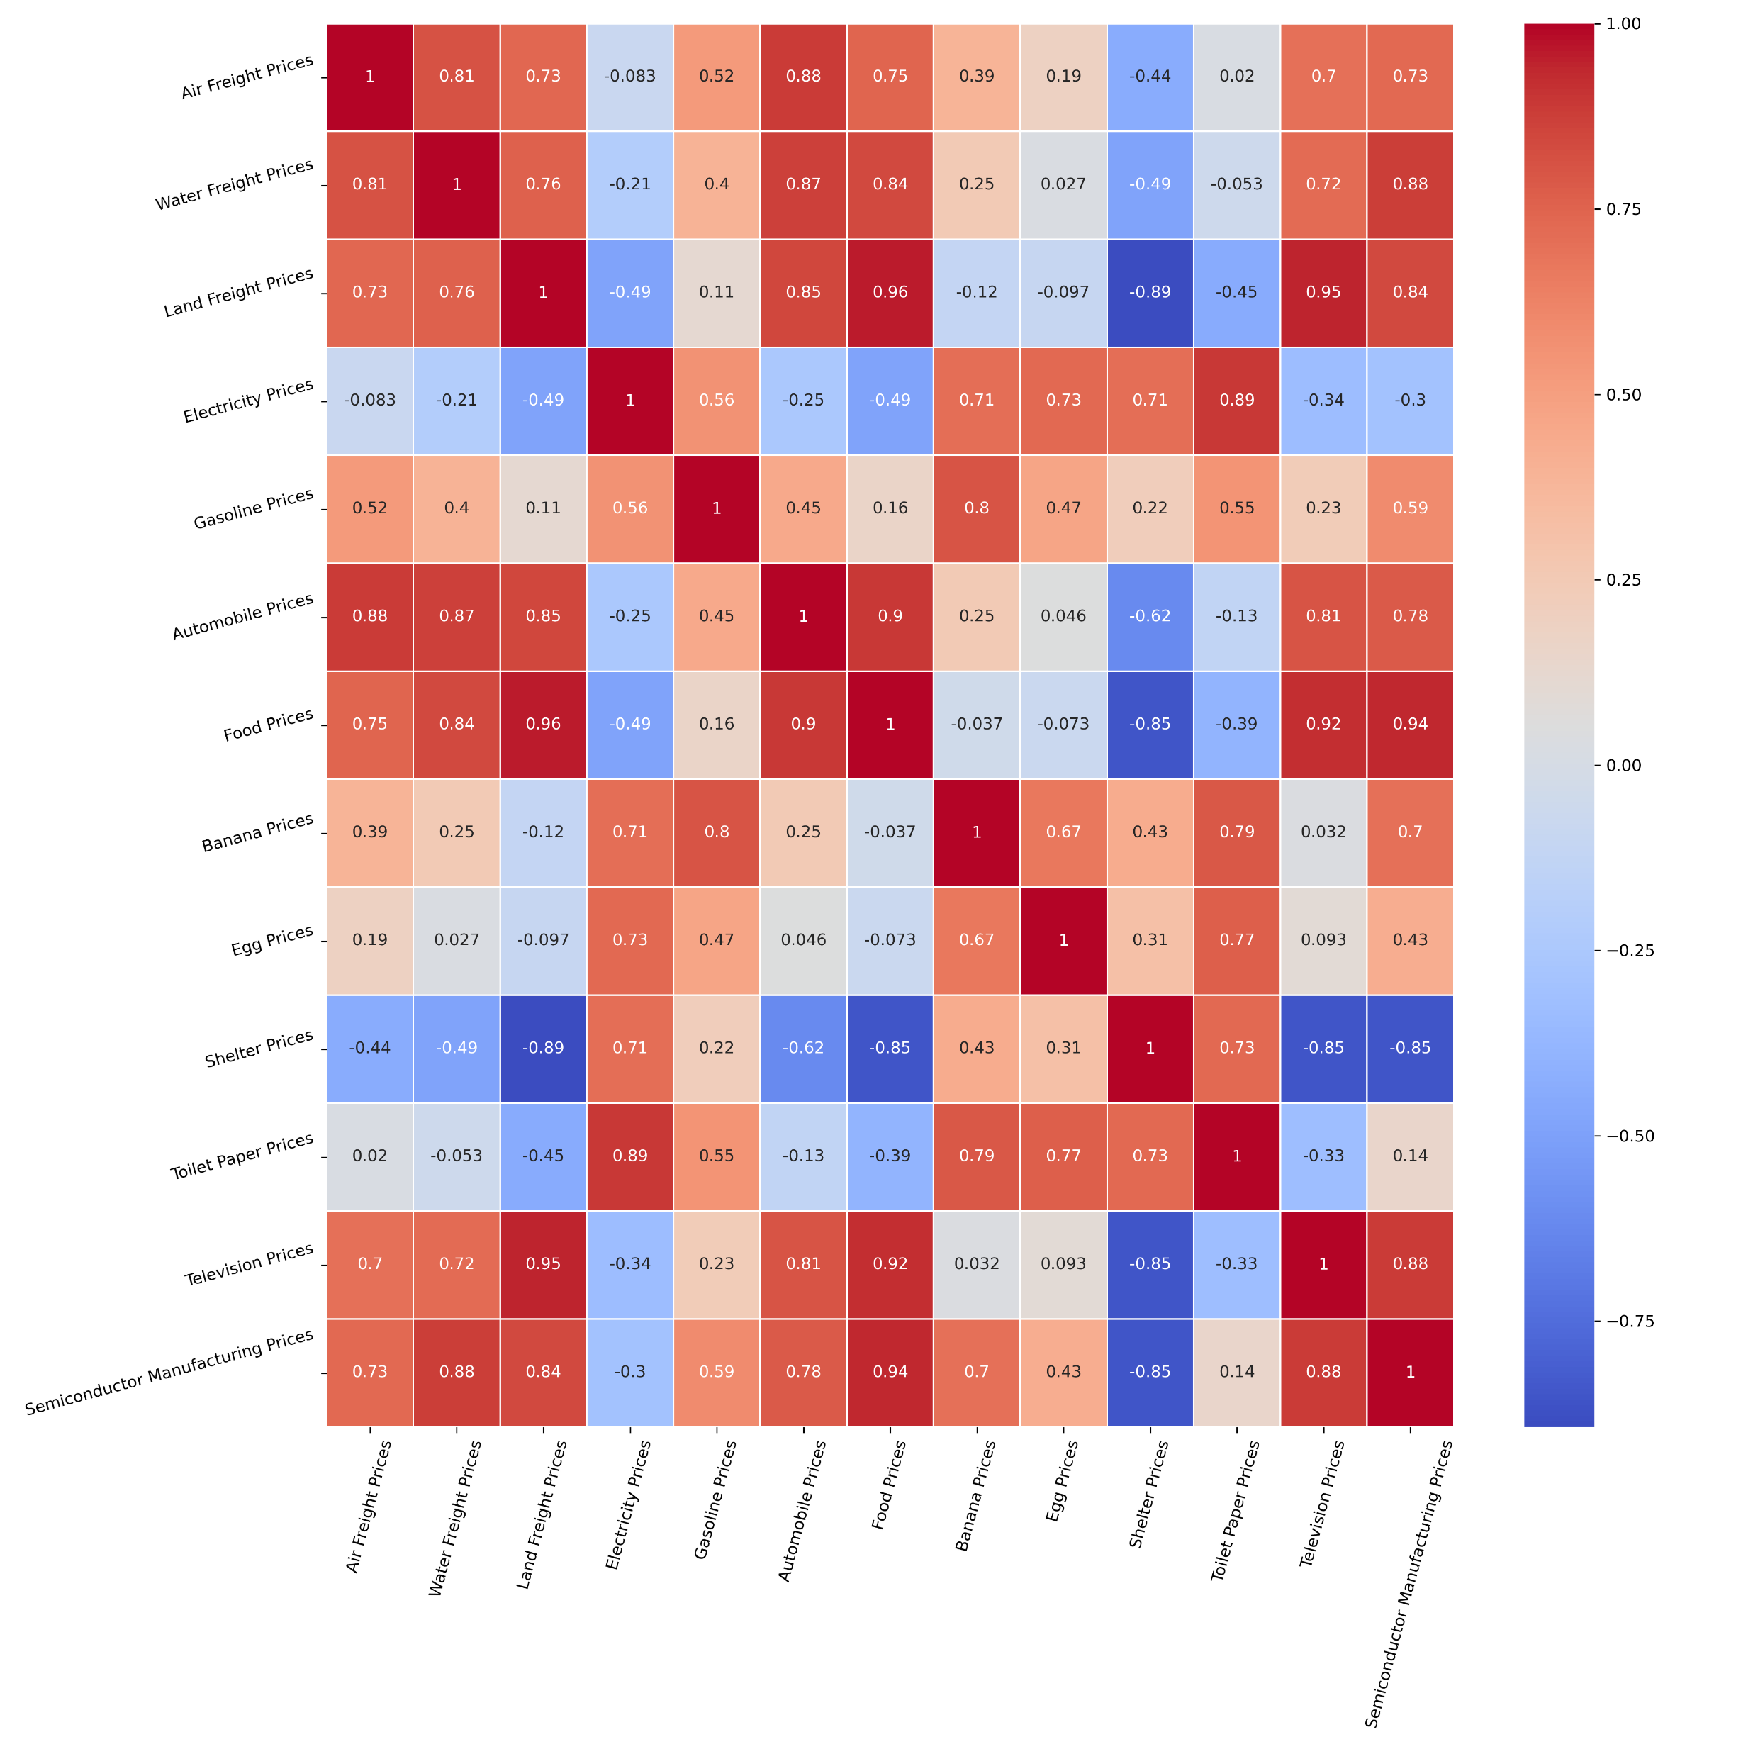
All correlation Matrix

Slide 10
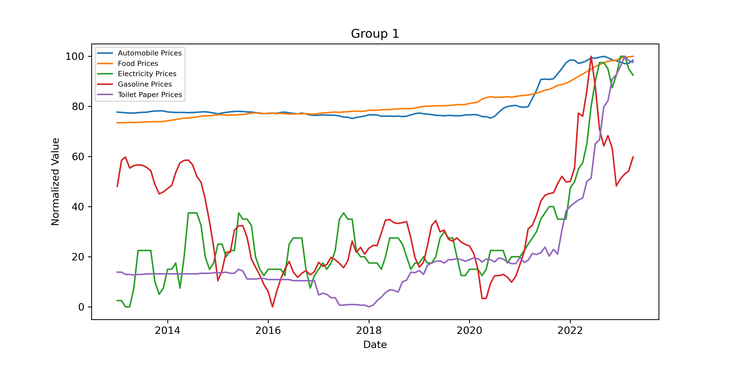
Automobile Prices Food Prices Electricity Prices Gasoline Prices Toilet Paper Prices

Slide 11
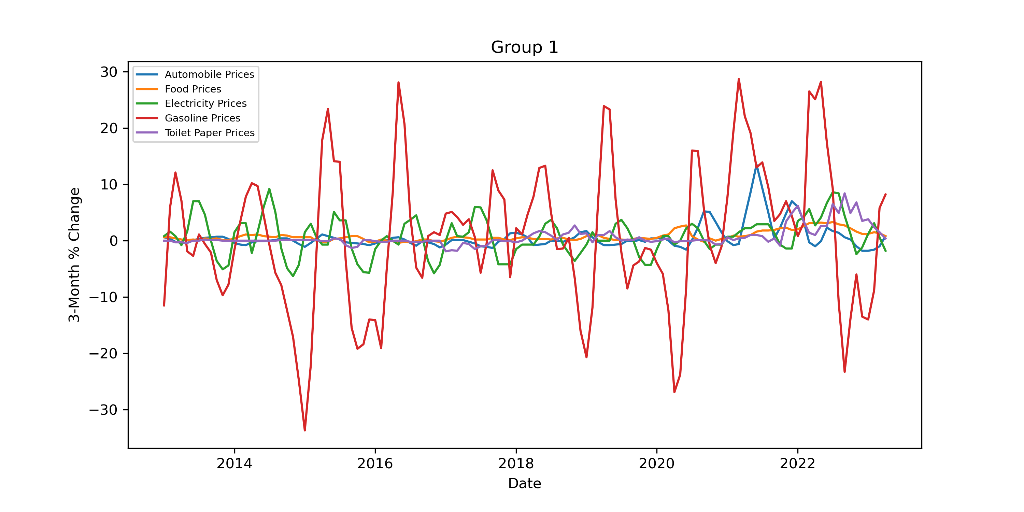
3 Month Percent Change

Slide 12
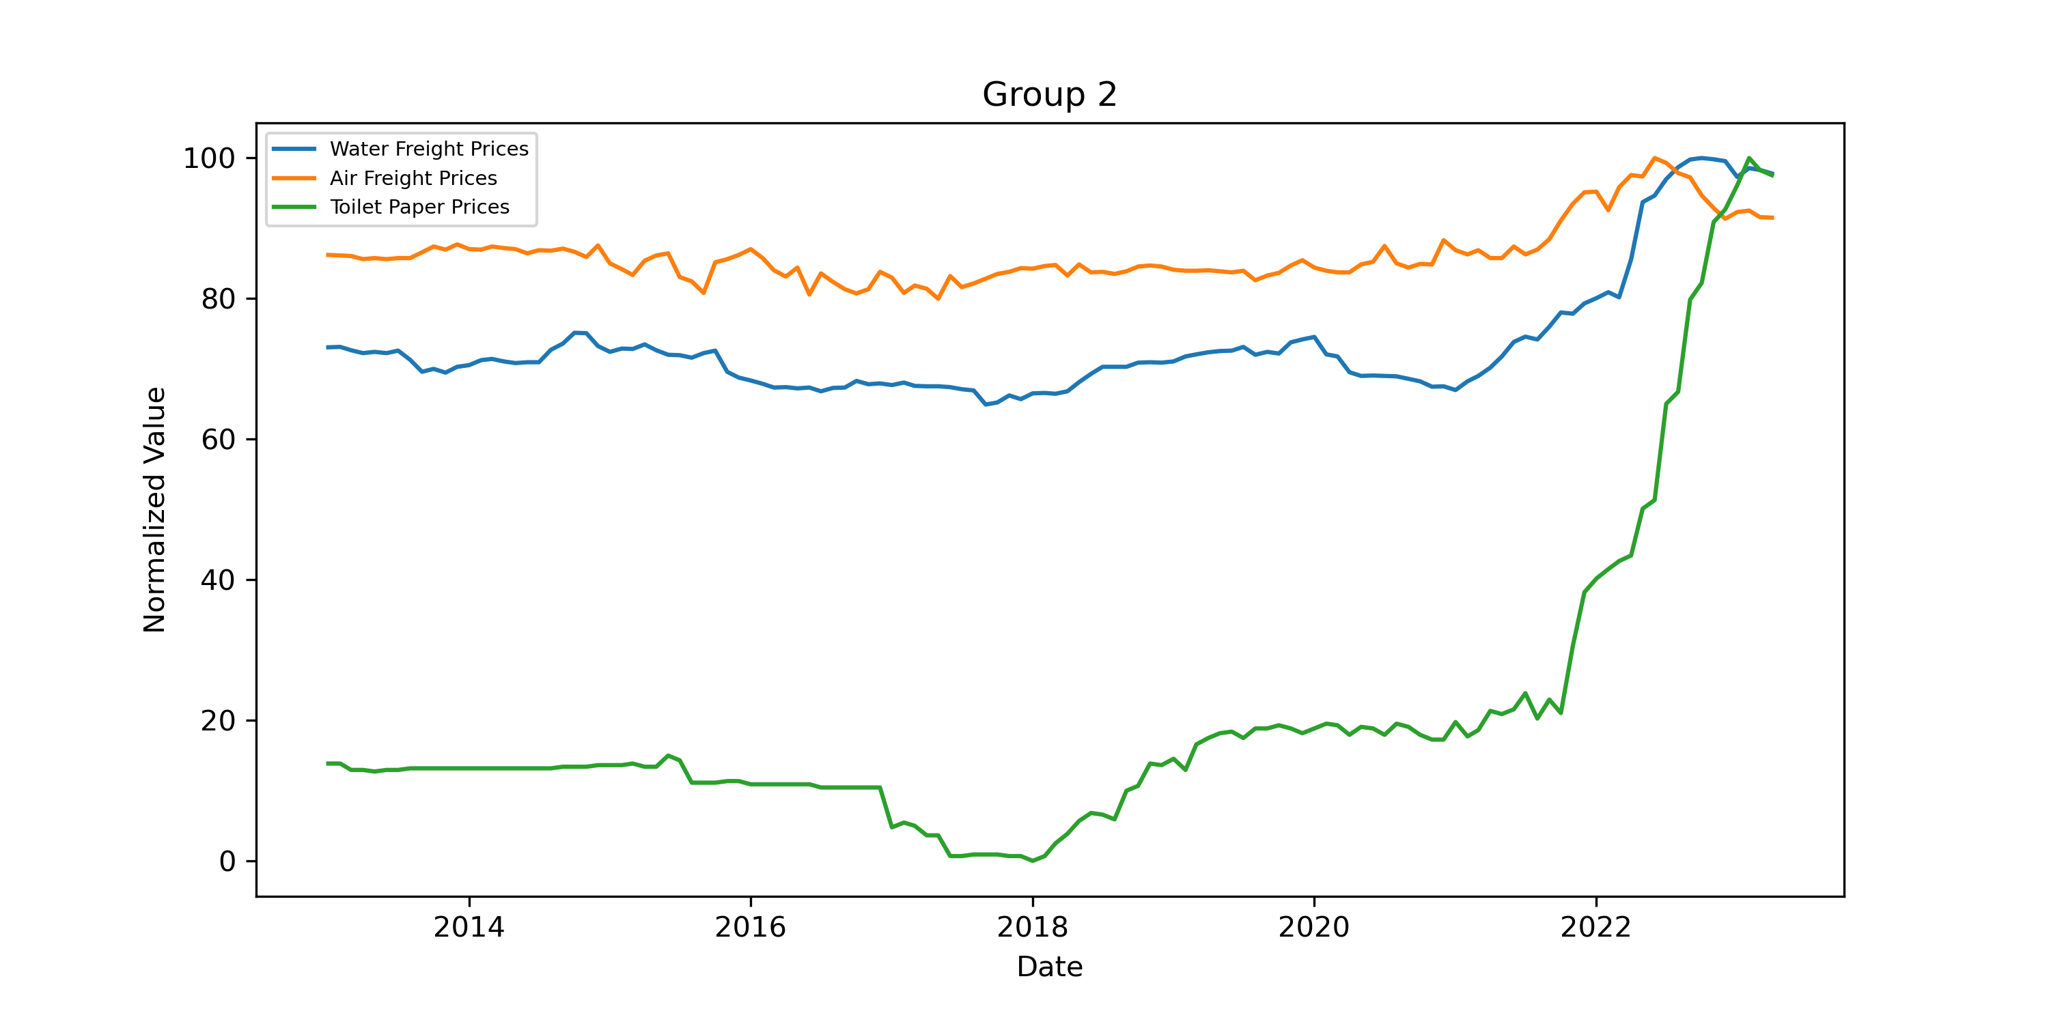
Water Freight Prices Air Freight Prices Toilet Paper Prices

Slide 13
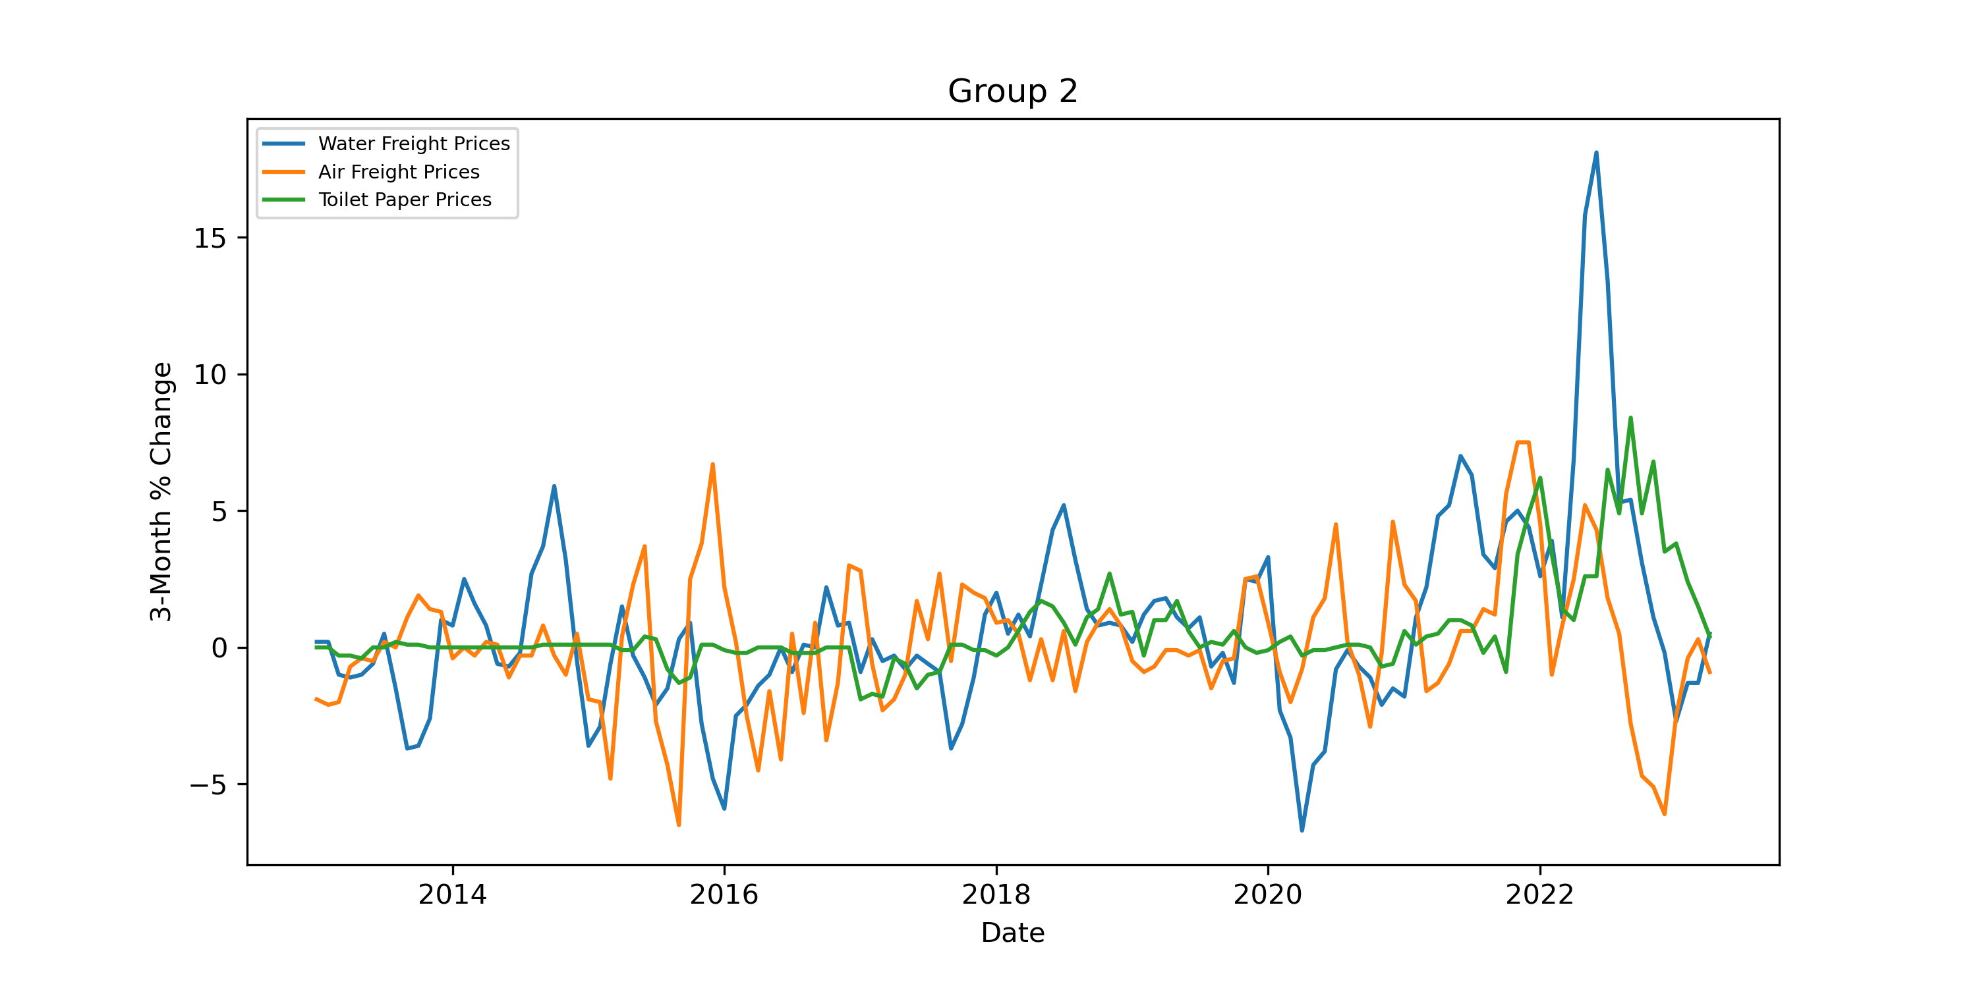
3 Month Percent Change

Slide 14
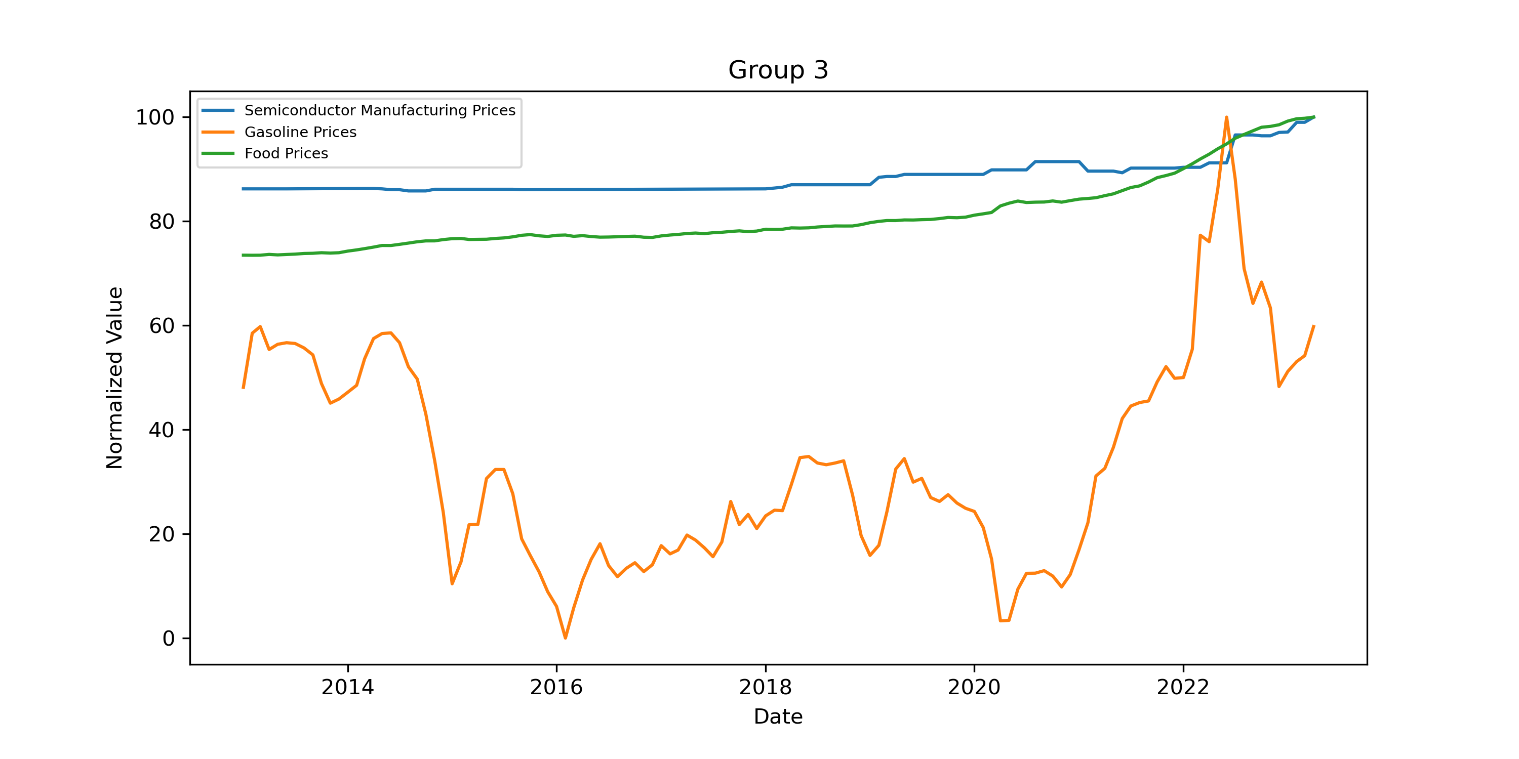
Semiconductor Manufacturing Prices Gasoline Prices Food Prices

Slide 15
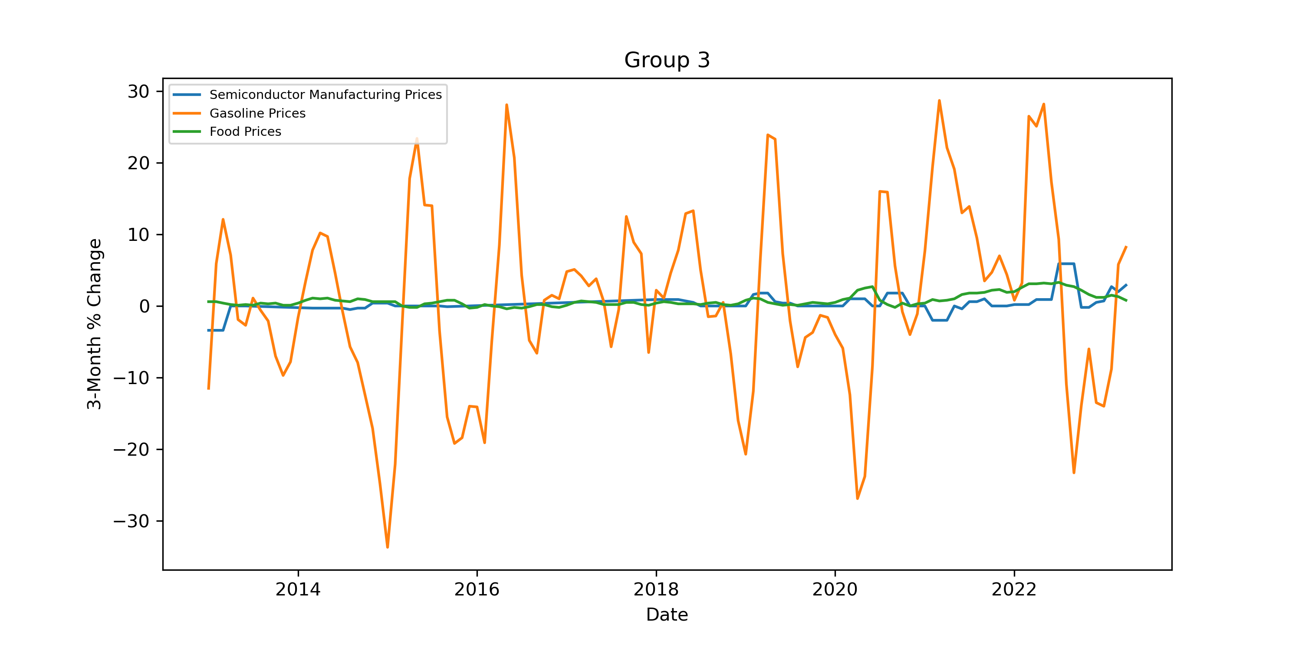
3 Month Percent Change

Slide 16
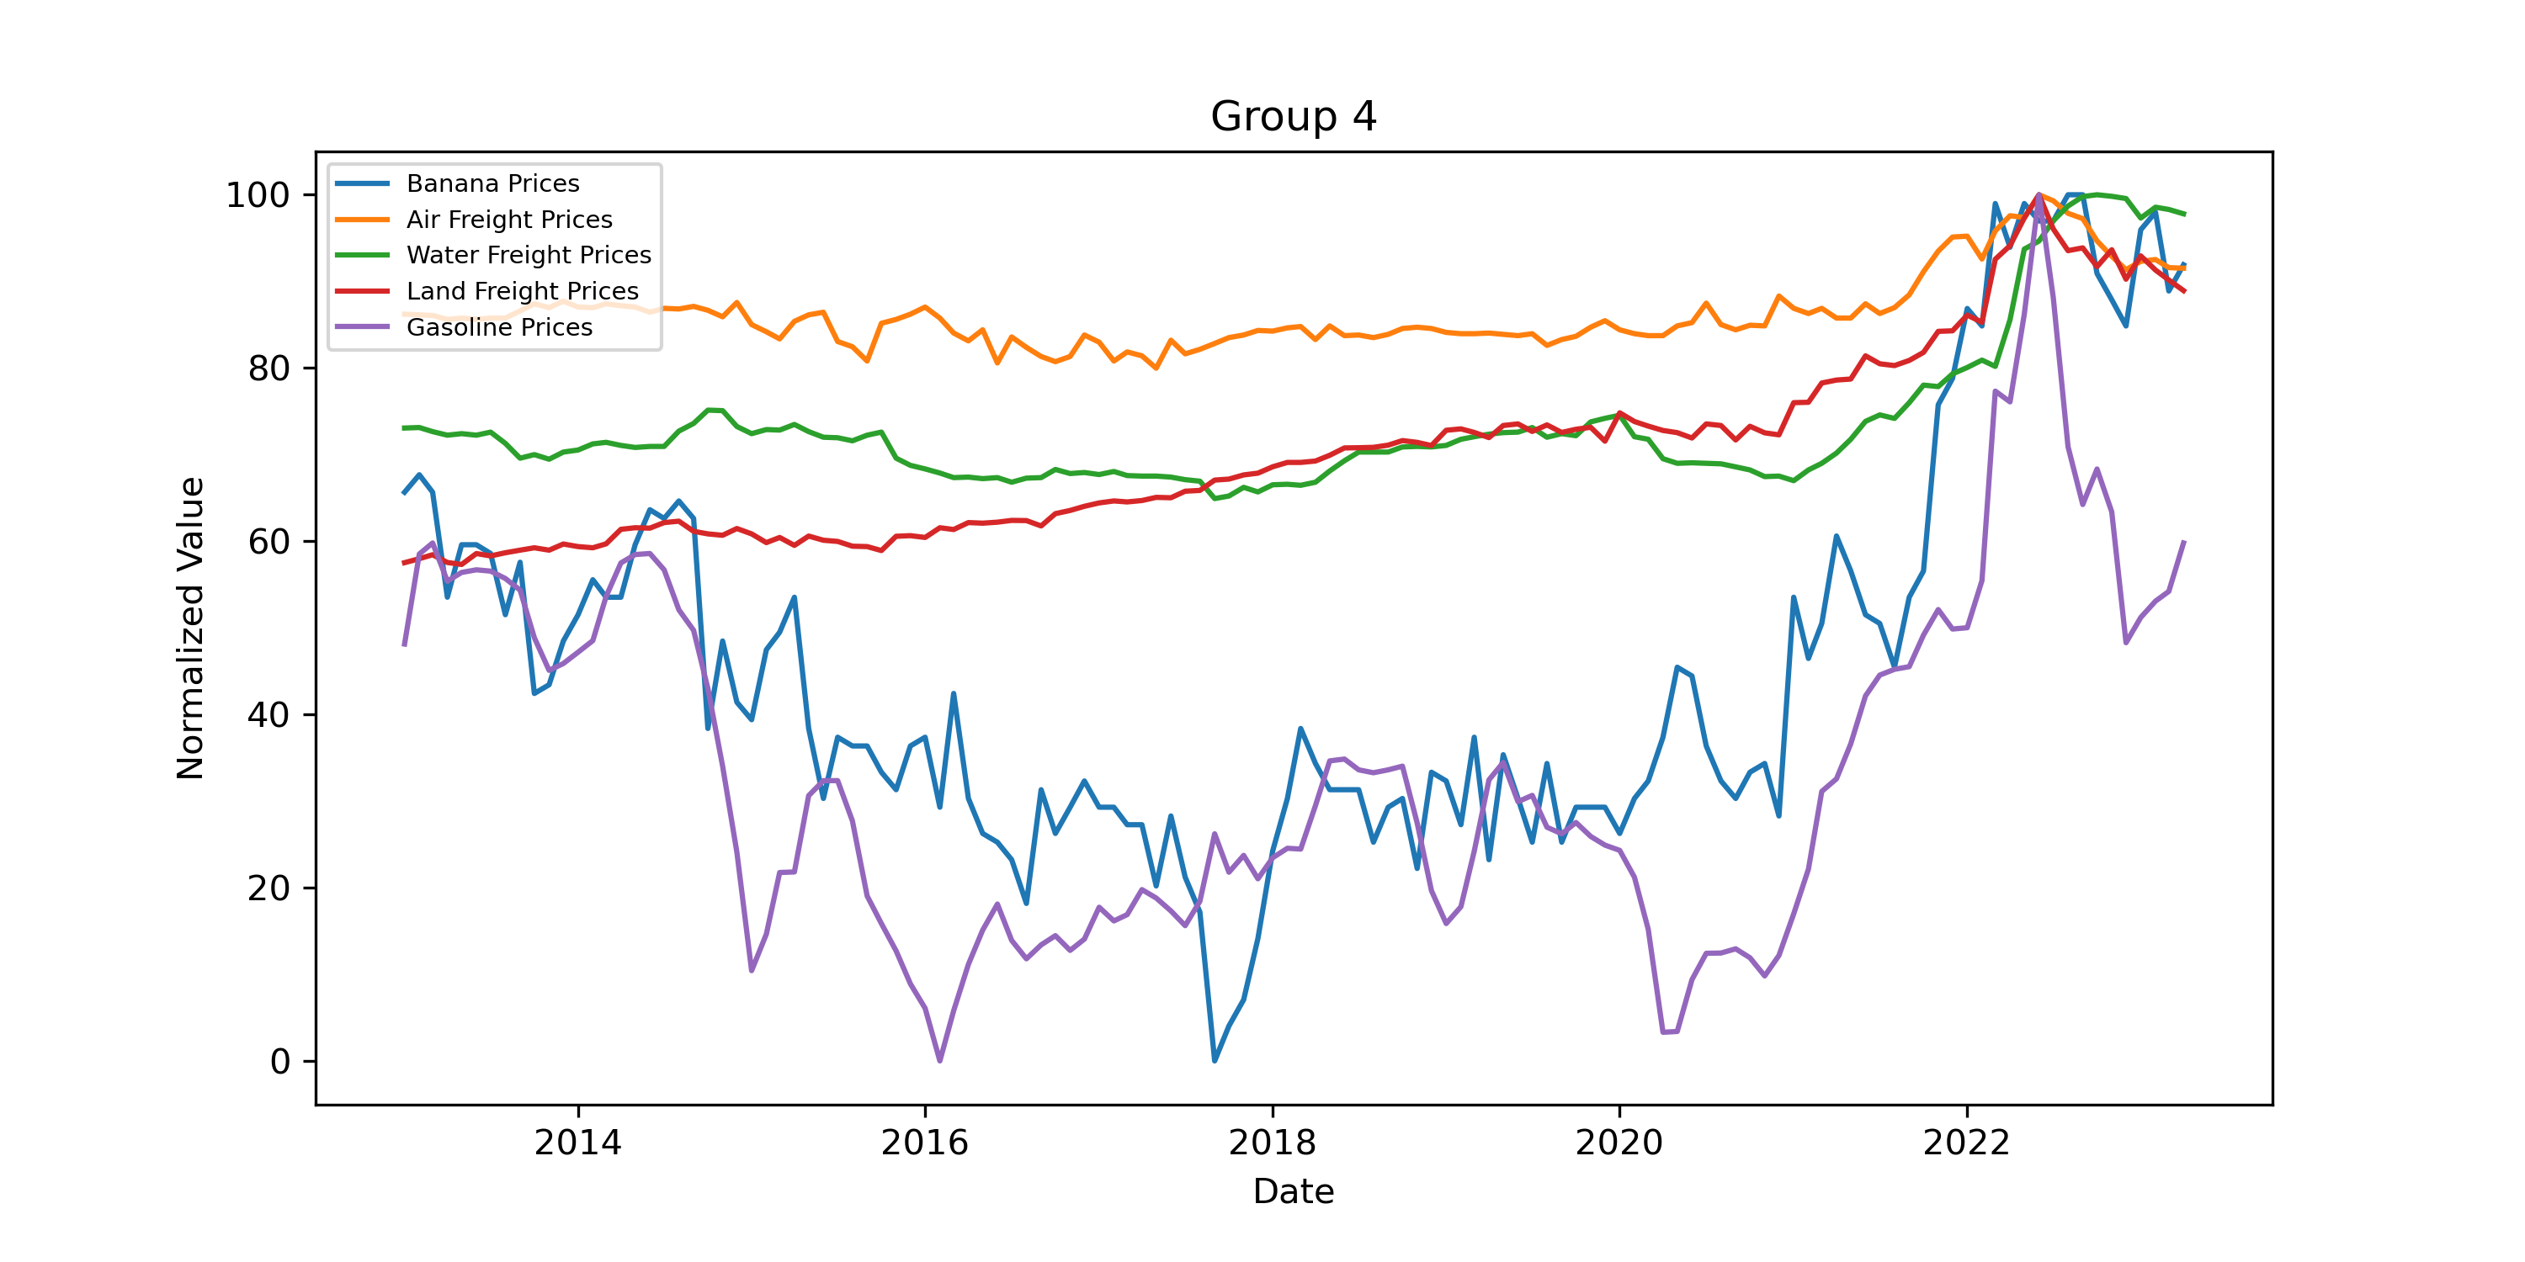
Banana Prices Air Freight Prices Water Freight Prices Land Freight Prices Gasoline Prices

Slide 17
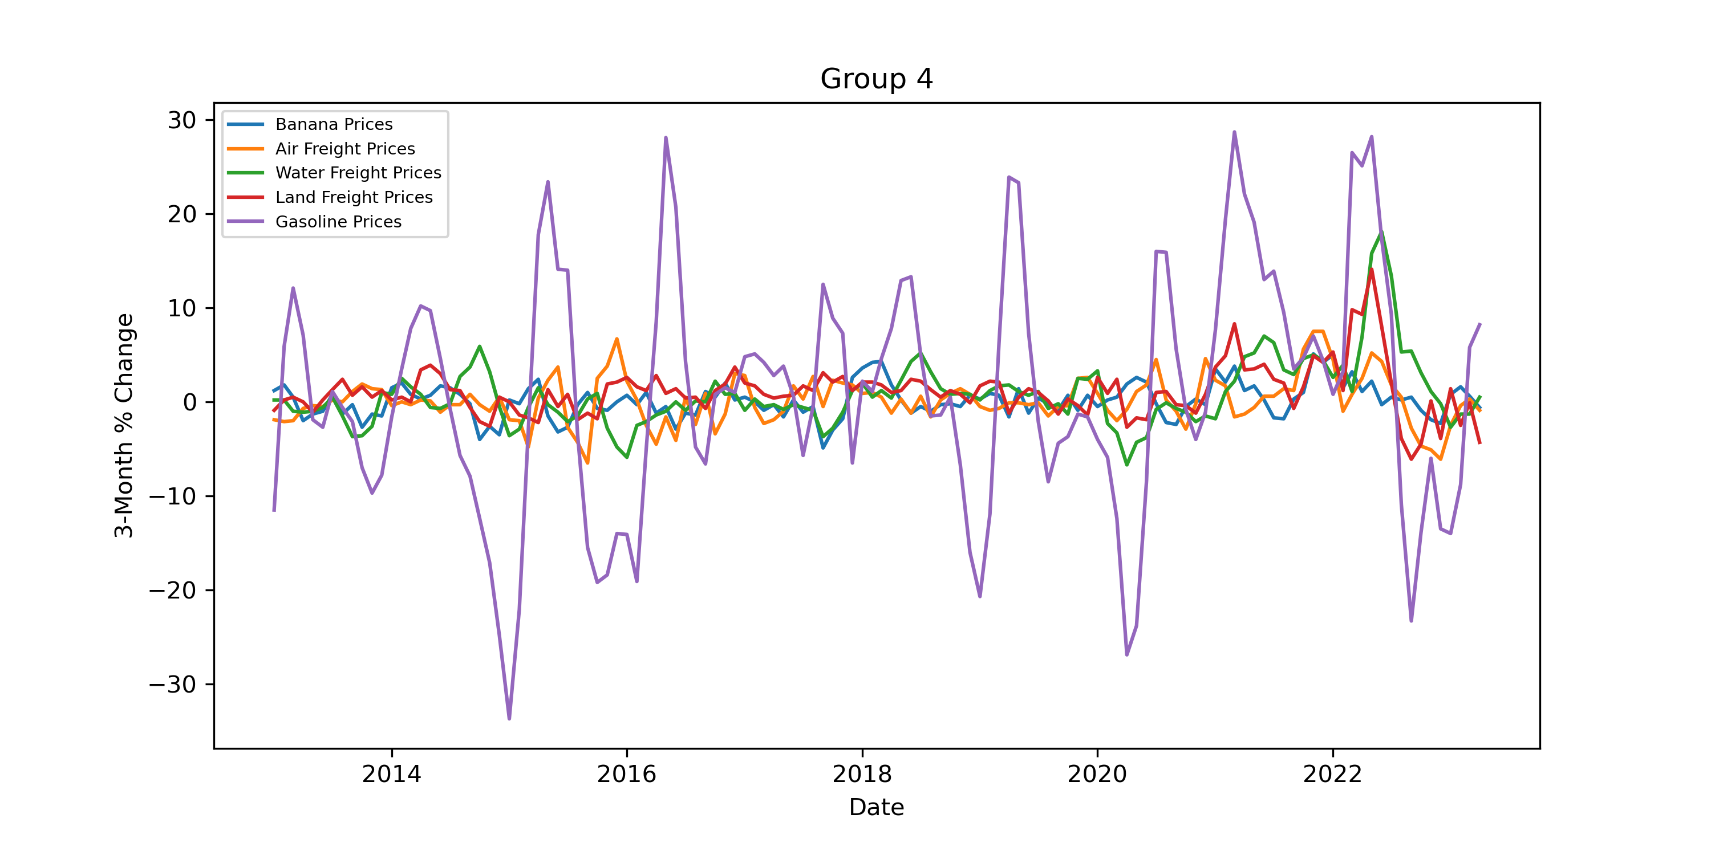
3 Month Percent Change

Slide 18
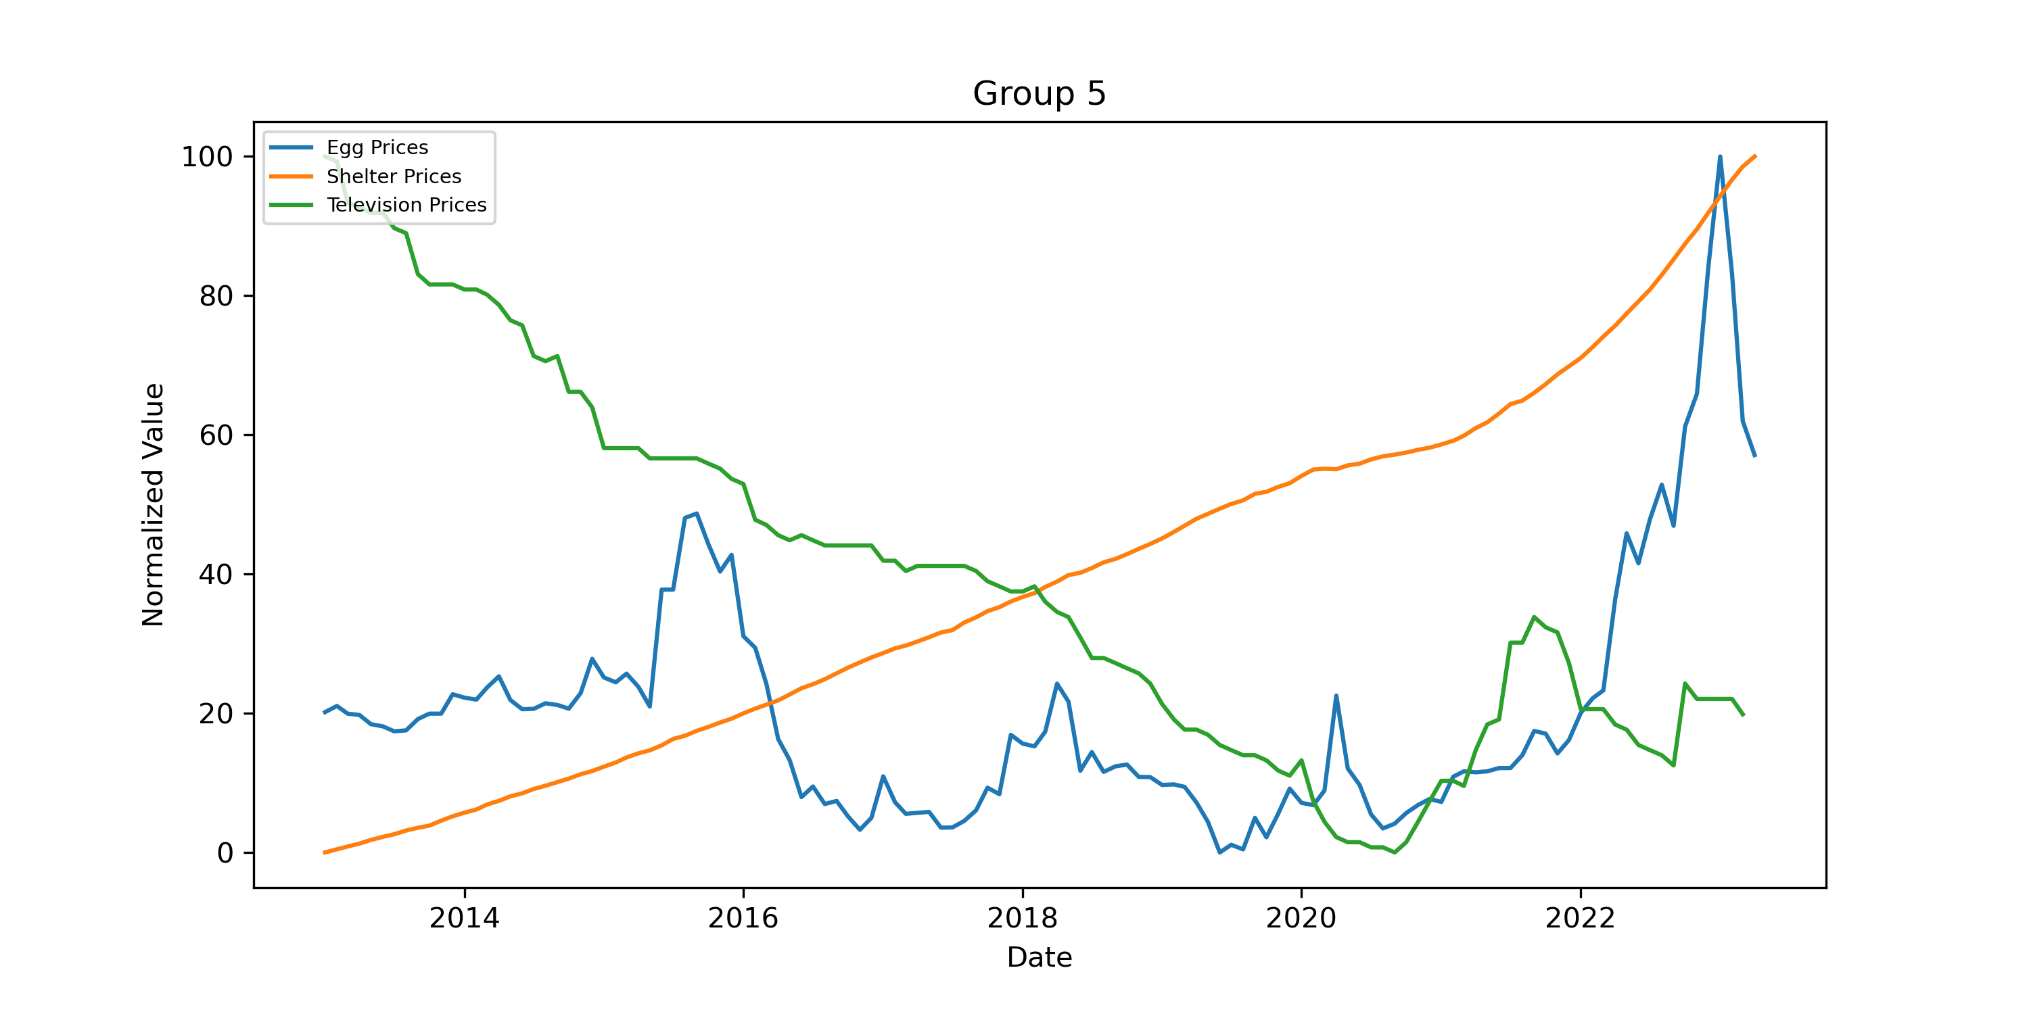
Egg Prices Shelter Prices Television Prices

Slide 19
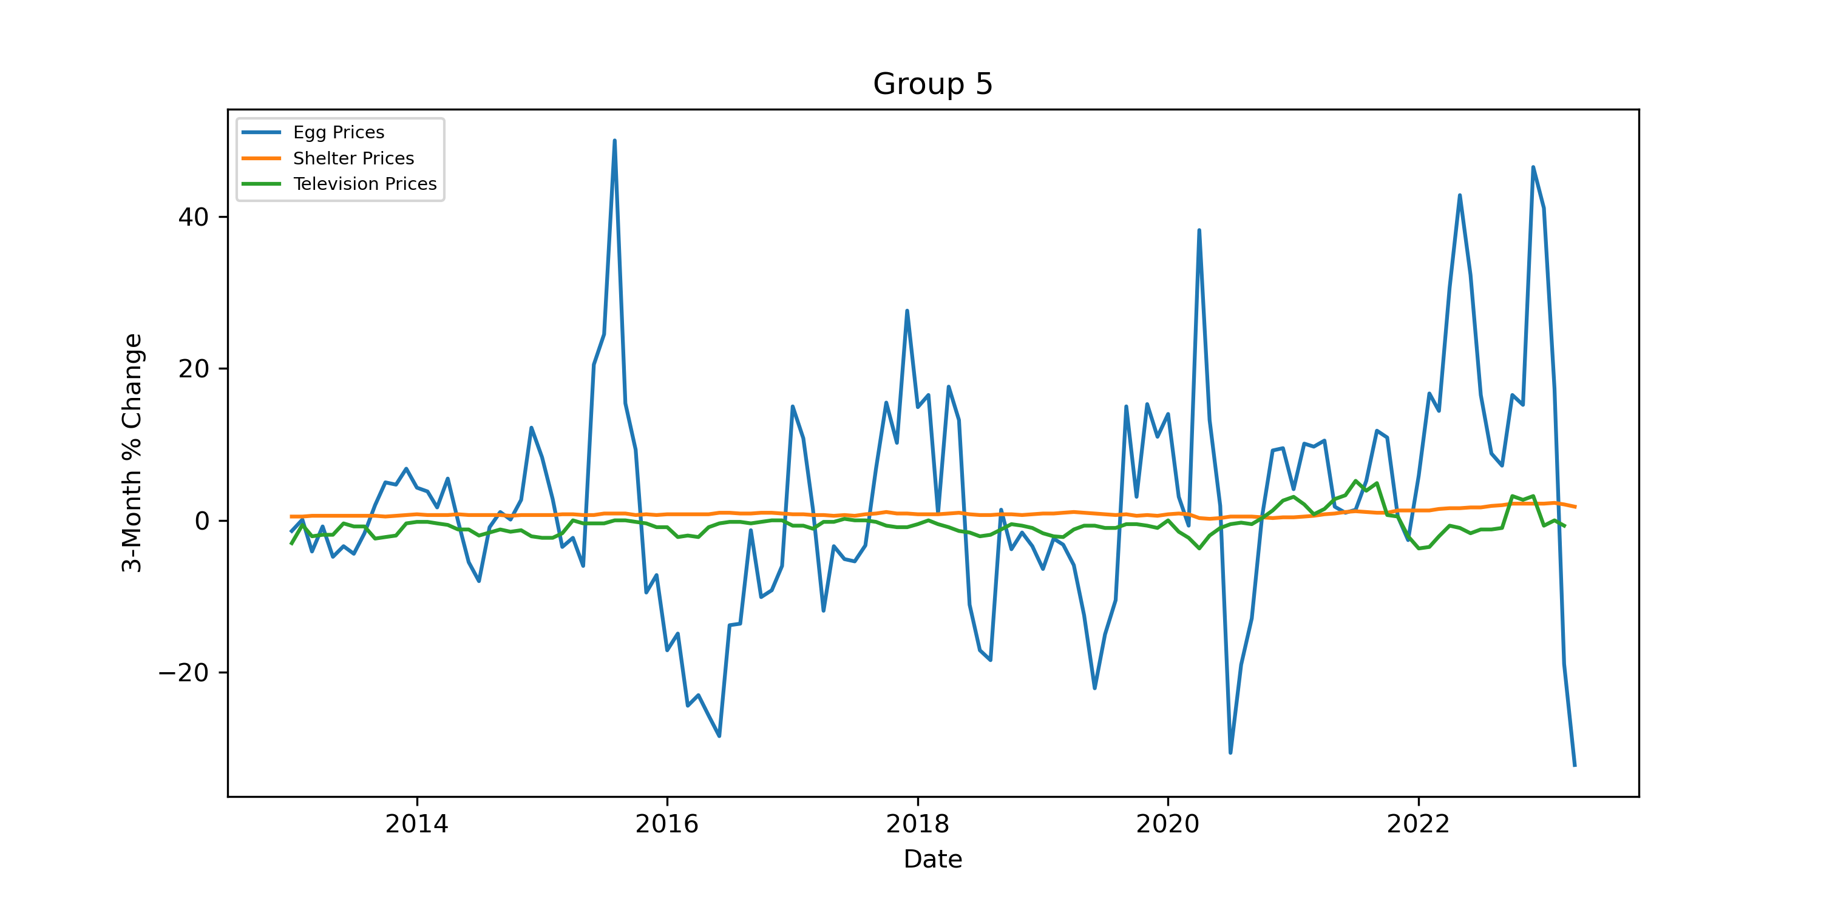
3 Month Percent Change

Slide 20
Syrian Civil War (2011-present): The conflict in Syria escalated in 2013 and has resulted in a devastating humanitarian crisis and regional instability.
2.Ukraine Crisis (2013-2014): Protests erupted in Ukraine after the government rejected closer ties with the European Union, leading to political turmoil and the eventual annexation of Crimea by Russia.
3.Ebola Outbreak (2014-2016): The Ebola virus outbreak in West Africa resulted in thousands of deaths and raised global concerns about public health preparedness.
4.Bird Flu (2014-2015)(2022-2023)
5.2014-2016 Oil Price Crash: In mid-2014, global oil prices began a steep decline. The price drop was attributed to a combination of factors, including a surge in global oil production, particularly from U.S. shale oil, slowing global economic growth, and a decision by OPEC (Organization of the Petroleum Exporting Countries) to maintain production levels rather than cut them. This led to an oversupply of oil in the market. As a result, oil prices fell from over $100 per barrel in mid-2014 to around $30 per barrel in early 2016.

Slide 21
6.Paris Climate Agreement (2015): The international climate agreement was adopted by nearly 200 countries, aiming to combat climate change and limit global warming.
7.Brexit Referendum (2016): The United Kingdom held a referendum on leaving the European Union, resulting in a majority vote in favor of Brexit.
8.U.S. Presidential Election (2016): Donald Trump, a Republican candidate, was elected as the 45th President of the United States, defeating Hillary Clinton.
10.Rohingya Crisis (2017-present): The persecution of Rohingya Muslims in Myanmar led to a massive refugee crisis, with thousands fleeing to neighboring Bangladesh.
11.North Korea Nuclear Crisis (2017-2018): North Korea conducted several missile tests and engaged in a war of words with the United States, raising concerns about nuclear weapons proliferation.
12.COVID-19 Pandemic (2019-present): The coronavirus disease pandemic caused by the novel coronavirus (SARS-CoV-2) has had a significant global impact, resulting in millions of infections and deaths, as well as widespread social and economic disruptions.
13.Black Lives Matter Protests (2020-present): Following the killing of George Floyd by a police officer in Minneapolis, protests against racial inequality and police brutality spread across the United States and around the world.

